Slide 1
Branding
More than just a logo.

Slide 2
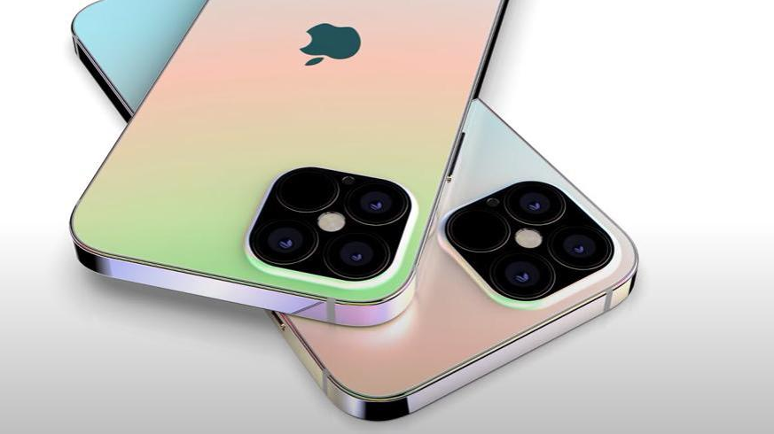
Brands that resonate
Immediately
recognizable
01
Create a relationship with the user
02
Create a feeling of success, and inclusivity
03

Slide 3
A good brand stands time and design
Branding, by definition, is a marketing practice in which a company creates a name, symbol or design that is easily identifiable.
This helps to identify a product and distinguish it from other products and services. Branding is important because not only DOES IT MAKE A memorable impression, but it allows your customers and clients to know what to expect from your company.
It is a way of distinguishing yourself from the competitors and clarifying what it is you offer that makes you the better choice. Your brand is built to be a true representation of who you are as a business, and how you wish to be perceived.

Slide 4
More than a logo – branding encompasses many things
Social media profiles
graphics
customer service
Promotional merchandise
Reputation
logo
All of these elements work together to create one unique and (hopefully) attention-grabbing professional profile.

Slide 5
branding
Drives new business
Increases brand awareness ( important to see yourself as a brand when speaking about your company)
Becomes known
Increases business value
Creates trust – shows that you take your business and in turn your client seriously
Creates a feeling of authority in your sector

Slide 6
The infamous logo
SHOULD BE EASY TO READ
SHOULD BE TIMELESS (EASILY CARRIED OVER TO IMAGES AND COLOUR PALLETES THAT ‘FEEL’ LIKE YOUR BRAND)
LOGO FONT SHOULD BE EASY TO PRINT AND TRANSLATE TO BOTH PRINT AND WEB
createS a cohesive and appealing advertising strategy that plays well into your LONG-TERM branding goals
BE EASILY CONVERTED TO A SIMPLE YET COHESIVE LOGO FOR SOCIAL MEDIA
EASILY HAVE VARIOUS LAYOUTS WITHOUT LOSING OVERALL STRENGTH OF THE LOGO

Slide 7
ALL THIS WORK AND IT COMES DOWN TO 2 THINGS, AND 2 THINGS ONLY.
SUCCESSFULLY DELEVERING THESE TWO FUNDMENTAL MESSAGES THROUGH BRANDING
Expertise and uniqueness
Notes:
V

Slide 8
ALL THIS WORK AND IT COMES DOWN TO 2 THINGS, AND 2 THINGS ONLY.
Expertise and uniqueness are the essential pillars behind any meaningful business.
knowing how to find the true differential that’s buried deep down is also essential, and why these two pillars are complementary. Whenever they are delivered with authenticity and expressed through a clear and powerful identity, they give a company its true edge and can make it become incredibly successful.
Notes:
V

Slide 10
Going through the identity creation process in the right way results in a brand that is not only beautiful and more professional but anchored to the core aspects and values of the business it represents.
That’s why the first step always must include a serious look at a company’s business plan, target market, industry, and competitors.
Then, with all the right information in place, the essential strategic concepts are crafted, and some specific human traits, like voice and personality, are attributed.
Through this process, the brand is created with focus on the target audience and becomes more appealing and relatable to them.
The visible identity then becomes much easier to determine and create.

Slide 11
COLOUR

Slide 12
Color And The Brain
Visual perception is the primary sense humans have for exploring and making sense of their environment. Colors trigger a diverse set of responses within the cerebral cortex of the brain and throughout the central nervous system. The proper perception of color has been one of the key drivers of human evolution. If color is that important to human evolution, just think how important it is to building the value of your brand.
We instantly have a chemical reaction in our brain that produces an emotional response. This response triggers a multitude of thoughts, memories and associations to people, places and events. Color affects us in profound ways. Our brains are designed to respond to color. This all happens instantly under our conscious awareness.

Slide 13
Selecting The Right Color For Your Brand
To convey a simple idea of meaning and differentiation requires you select a color that properly fits your strategic positioning. Selecting a color (and color scheme) for your brand must represent the audience emotional associations and desires, and the value proposition or promise your brand brings to your customer.
Selecting the appropriate color to represent and differentiate your brand must be based on several criteria.
Here are two of the most important:
Target Audience
Industry

Slide 14
Selecting The Right Color For Your Brand
To convey a simple idea of meaning and differentiation requires you select a color that properly fits your strategic positioning. Selecting a color (and color scheme) for your brand must represent the audience emotional associations, and the value proposition or promise your brand brings to your customer.
Selecting the appropriate color to represent and differentiate your brand is based on several criteria but the two most important areas to consider and develop for are:
Target Audience
Industry

Slide 15
FONTS MATTER
CLARITY MATTERS
SIZE MATTERS
SPACING MATTERS

Slide 16
TYPOGRAPHY
It is your communication. Clarity is critical, particularly on the web and in digital media. There is nothing more frustrating than not being able to read a paragraph clearly when looking for information on a website.
Keep it simple! Decorative font is an accent and should never replace clean fonts for important copy.
Cursive or handwritten fonts should be very easy to read and limited to introduction areas.
Sans Serif and Serif both offer clean, easily translated (from print to web) options and should supersede any personal likes or dislikes. This is not about you – you must work with fonts with your client or end user in mind.

Slide 17
FONT ATTRACTS THE READER
Font should be as clean as possible. It shouldn't be too small and crummy. Using fonts give your customer comfort in continuing to read. Fonts that are ill spaced or decorative are hard on the eyes and do not lend well to allowing your customer to read the information they need.
Poor choice in font often leads to something we call ‘a bounce’ where your customer reach's your site but simply can’t find the information or they aren’t comfortable reading through it.
The choice of such font determines how the content is understood. It also
Creates professionalism
Builds brand recognition

Slide 18
CONSIDER FLEXIBLE FONTS THAT ARE EASILY READ ACROSS PLATFORMS
SAN SERIF FONTS:
MONTSERRAT
RALEWAY
ROBOTO
SERIF FONTS
GEORGIA
GARAMOND
Notes:
GUAR

Slide 19
Complete your branding document
This is the ‘brainstorming part’, no answer is incorrect, note bullet points and thoughts as that will allow us to drill down and improve on target points
Take time to think through how you envision your growth – no such thing as thinking too big – what success do you really want to see?
Again – no wrong answer but envision success and growth, how would that look? What would you consider success?
NEXT STEPS
PLEASE RETURN YOUR BRANDING QUESTIONNAIRE TO ME DIRECTLY NO LATER THAN MONDAY, OCTOBER 26TH.
Notes:
GUAR

Slide 20
YOUR VOICE
Once we have your initial thoughts on how you envision your brand, we will focus on defining and refining your story.
Tuesday, October 27th, we will cover copy writing, taglines and online communication.
We’ll develop your message and your focus/touch points we will start to break out your service points and create copy for those areas based on the emotional feel we are trying to relay online – that will then help us to build your digital presence.
NEXT UP!
Notes:
GUAR

Slide 21
November 5th
Participant round table
15 minute segments, each business will introduce their business focusing on their improved brand and allow everyone to get a real sense of how their message translates in the ‘elevator speech’.
Notes:
GUAR

